Slide 1


Comparative Analysis of Ensemble Learning Techniques for Stock Price Prediction using Machine Learning
Sardar Vallabhbhai National Institute of Technology, Surat
Presented by:
Tanishk Varshney Raj Mangukiya Priyanshu Kumar
Course Id: MA-308
under the supervision of Dr. Sourav Gupta

Slide 2
Outlines
Introduction
Objectives
Machine Learning Approaches
Implementation
Results
Conclusion and Future Scope

Slide 3
Introduction
Stock price prediction is inherently challenging due to high market volatility, investor psychology, and geopolitical uncertainties. Traditional statistical models often fail to capture such nonlinear and complex patterns effectively, limiting their forecasting accuracy.
Machine learning, particularly ensemble methods like Random Forest and Gradient Boosting, offer a powerful alternative by combining multiple decision trees to improve prediction stability and performance. These models are widely used in financial forecasting due to their ability to handle noisy, real-world data.
This study introduces a stacked ensemble approach that integrates Random Forest and Gradient Boosting as base learners with a meta-model to enhance adaptability to sudden market shifts. The objective is to improve predictive performance, reduce overfitting, and provide a more robust framework for real-world stock forecasting applications.

Slide 4
Objectives
Thoroughly compare the prediction capabilities and resilience of traditional machine learning models such as Random Forest and Gradient Boosting with a stacked ensemble meta-model, aiming to identify the most effective approach for forecasting stock prices in volatile markets.
Implement an end-to-end data preprocessing pipeline, which includes techniques like feature engineering, outlier removal, and hyperparameter tuning, to enhance the accuracy, consistency, and robustness of the models being trained.
Evaluate and validate all models using multiple regression metrics such as Mean Squared Error (MSE), Mean Absolute Error (MAE), and the R² score, focusing not only on predictive accuracy but also on identifying signs of overfitting and assessing model generalization capability.

Slide 5
Machine Learning Approaches
Random Forest (RF): A baseline ensemble method that constructs multiple decision trees in parallel using bootstrapped samples and random feature selection, combining their outputs through averaging to reduce variance and overfitting.
Gradient Boosting (GB): A sequential ensemble technique where each new tree is trained to correct the residual errors of the previous ones, making it highly effective for capturing complex patterns and minimizing bias in stock price predictions.
Stacked Ensemble: A meta-learning technique that integrates the predictive outputs of both RF and GB as inputs into a final model (meta-model), leveraging the strengths of each base learner to improve generalization and prediction accuracy.

Slide 6
Random Forest
Random Forest is a powerful machine learning technique that operates by creating hundreds of decision trees during training. Unlike a single decision tree that might overfit to the training data, it combines predictions from many trees to produce more accurate and stable results. This ensemble approach makes it one of the most reliable algorithms for both classification and regression tasks.
Working of Random Forest :
Bootstrap Sampling (Bagging) - The algorithm starts by creating multiple random subsets of the original dataset. Each subset is generated by randomly selecting data points with replacement, meaning some points may be repeated while others are left out. This ensures each decision tree in the forest trains on slightly different data.
Feature Randomization - When building each tree, at every decision node, only a random subset of features is considered for splitting like if there are 20 features, the algorithm might only evaluate 5 randomly chosen features at each node. This randomness forces trees to diversify and prevents any single feature from dominating predictions.

Slide 7
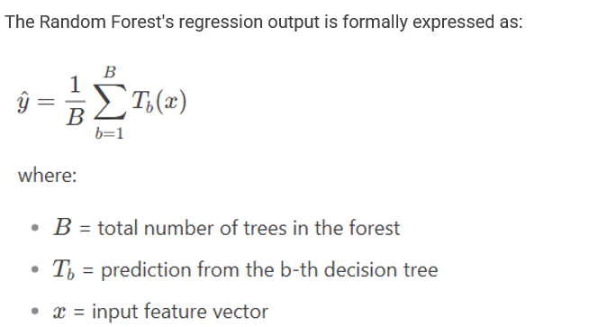
Prediction Aggregation - For classification tasks, each tree "votes" for a class, and the most frequent vote becomes the final prediction. In regression, the predictions from all trees are averaged to produce the output. This aggregation step cancels out individual tree errors, leading to more robust results.
Mathematical Formulation

Slide 8
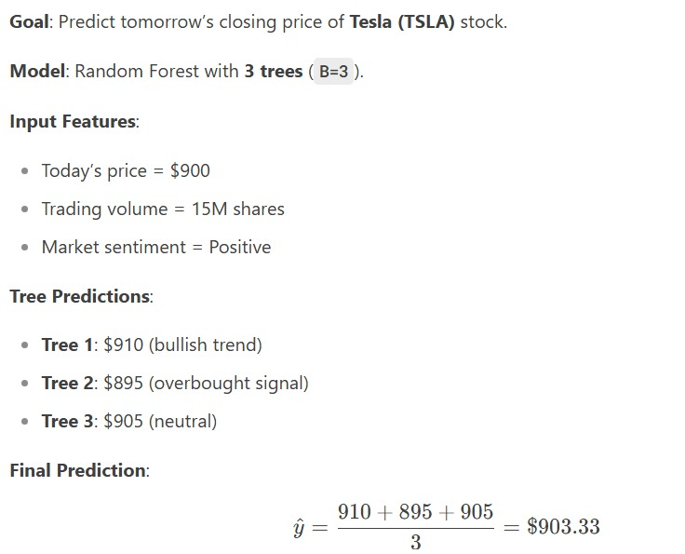
Example:

Slide 9
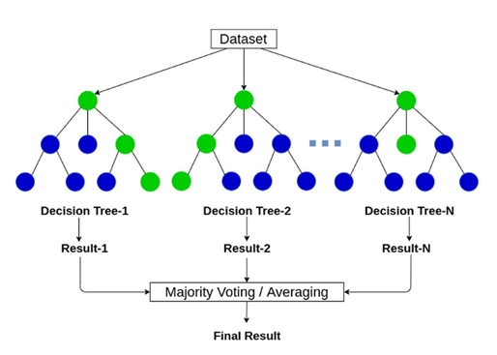
Random Forest

Slide 10
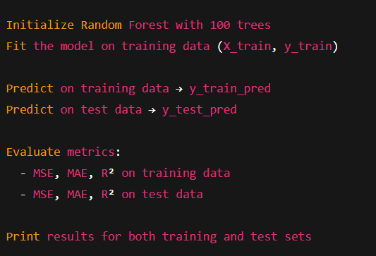
Pseudo Code

Slide 11
Real World Applications:
Banking & Finance: Random Forest is widely used for credit scoring to evaluate the likelihood of loan defaults based on borrower history, and for fraud detection by learning to identify irregular transaction patterns in large volumes of financial data.
Healthcare: In medical diagnosis, Random Forest models are used to predict diseases such as diabetes or cancer by analyzing patient records and biomarkers. It also plays a role in drug discovery by modeling the interactions between compounds and biological targets.
Retail & Technology: Businesses apply Random Forest to forecast customer churn, personalize marketing strategies, and understand buying behavior. In tech systems, it's also used for anomaly detection by flagging unusual patterns in system performance or user activity logs.

Slide 12
Gradient Boosting
Gradient Boosting is a sequential ensemble technique that builds multiple weak learners (typically decision trees) in stages, with each new model correcting errors made by previous ones. Unlike Random Forest which uses parallel tree-building, GB constructs trees one-after-another to gradually minimize prediction errors.
Working of Gradient Boosting :
Sequential Tree Building with Error Correction - It starts with a simple initial model, each subsequent weak learner (typically shallow decision trees) is trained to correct the residual errors (actual value – current prediction) of all previous trees. Unlike Random Forest (parallel training), trees are built one after another, with each step optimizing the ensemble’s overall accuracy.
Residual-Focused Learning & Shrinkage - After each iteration, the algorithm calculates gradients (derivatives of the loss function) to identify patterns in errors. New trees are trained exclusively on these errors, progressively reducing the ensemble’s residual loss. Predictions are scaled by a learning rate η.

Slide 13
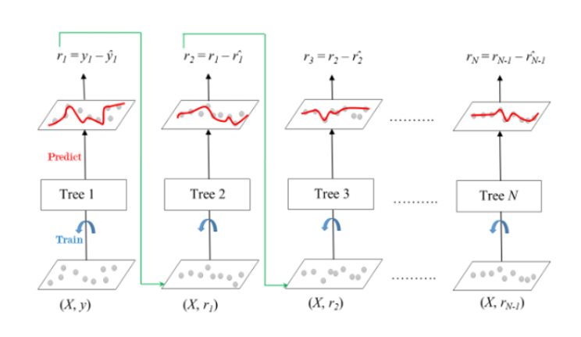
Gradient Boosting

Slide 14
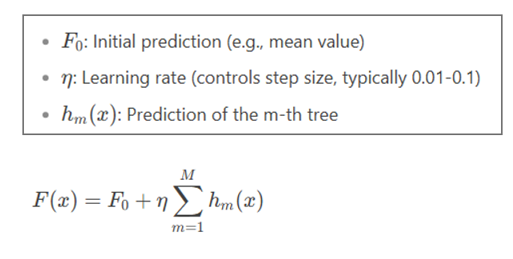
Additive Prediction Aggregation -
Final prediction = sum of all tree predictions, weighted by the learning rate

Slide 15
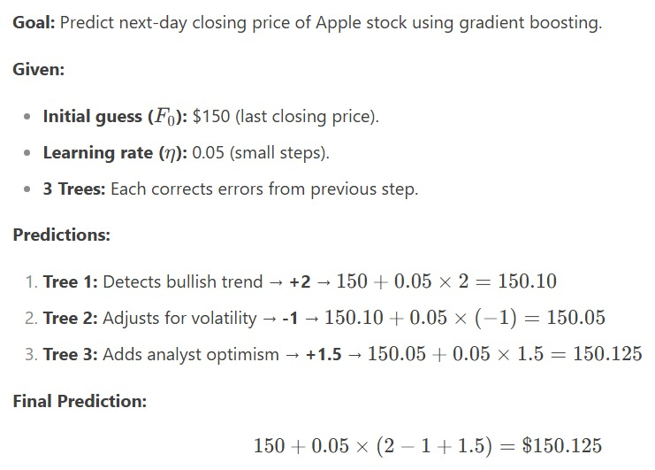
Example:

Slide 16
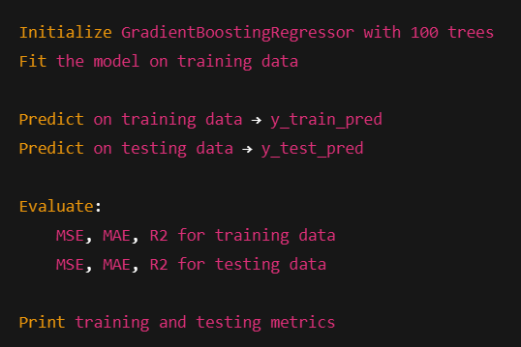
PseudoCode

Slide 17
Real World Applications:
Finance: Gradient Boosting is widely used for credit scoring, fraud detection, and stock price forecasting. It models complex, nonlinear relationships in high-dimensional financial data. Its predictive accuracy helps banks and trading systems make informed decisions.
Healthcare: Used for predicting disease outcomes, patient risk scoring, and drug response modeling. It handles structured medical data like lab results and patient demographics. Gradient Boosting improves early diagnosis and personalized treatment strategies.
Marketing & E-Commerce: Applied in customer churn prediction, segmentation, and recommendation systems. It learns user behavior patterns from transaction and browsing data. This helps businesses target customers more effectively and boost retention.

Slide 18
Models Stacked - Stacking
A stacked ensemble model combines predictions from multiple base models using a meta-model, aiming to create a more accurate and robust prediction. This technique leverages the strengths of different models to improve overall performance. It is also known as stacked ensembles or stacked generalization.
Working of Stacking :
Identify relevant features, clean the dataset, and split it into training and validation sets. Choose diverse base models to ensure varied error patterns and complementary strengths.
Train each base model using a unique algorithm or configuration on the training set. Base models predict the validation set. Their outputs become input features for the meta-model.
A final learner (e.g., linear regression or neural network) is trained using base model predictions. Meta-model combines base model predictions on test data to generate final predictions. Evaluate stacking performance using metrics like accuracy, precision, recall, and F1 score.

Slide 19
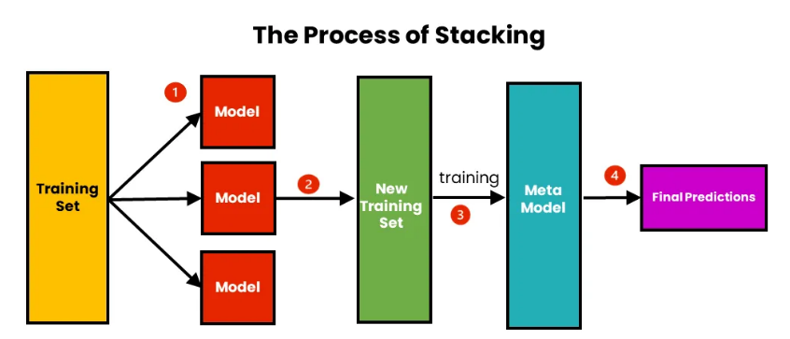
Stacking

Slide 20
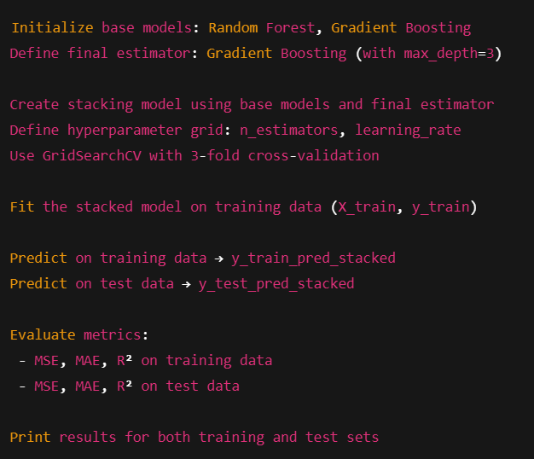
PseudoCode

Slide 21
Real World Applications:
Stock Market Prediction : Stacking is highly effective in financial time-series forecasting. It combines the predictive strengths of models like Random Forest, Gradient Boosting, and Support Vector Machines to analyze technical indicators and patterns in historical stock prices. This helps in producing more reliable future price predictions, especially in volatile markets.
Medical Decision Support : In healthcare, stacking models are used to assist in diagnosis and treatment planning. Different machine learning models trained on medical imaging, patient history, and genetic data are stacked to increase diagnostic accuracy. It reduces false positives/ negatives and supports clinical decisions in areas like cancer detection or disease classification.
Fraudulent Activity Detection : In sectors like e-commerce and banking, stacking helps in detecting fraudulent transactions. It combines models that capture unusual behavior patterns, transaction anomalies, and geolocation inconsistencies. By aggregating different perspectives, the ensemble model reduces the risk of fraud slipping through undetected.

Slide 22
Implementation
Library Imports : Various Python libraries such as pandas, numpy, and yfinance are imported. These libraries assist with data manipulation, numerical computations, and financial data retrieval. yfinance is specifically useful for downloading real-time and historical stock market data.
Machine learning modules are imported from the scikit-learn library. This includes models like RandomForestRegressor, GradientBoostingRegressor, and tools like train_test_split. Additionally, performance metrics and stacking tools are imported to build and evaluate ensemble models.
Data Collection : Use yfinance to collect historical stock data. The yfinance library helps fetch financial data like Open, Close, and Volume directly from Yahoo Finance. It supports customizable date ranges and stock tickers for flexibility in financial analysis.
Define the get_stock_data() function to takes a ticker and date range as input, uses yf.download (ticker, start=start date, end=end date) to retrieve the data, and returns it as a DataFrame. This modular setup simplifies repeated data fetching during training and testing.

Slide 23
Feature Engineering : Generating moving averages as trend indicators, these features (SMA_5, SMA_10) are created by taking the 5-day and 10-day rolling mean of the closing prices. These averages capture short-term and medium-term trends for the stock.
Creating momentum and return-based features like Rate of Change (ROC_5) and Daily Return features are added using percentage changes. They reflect the speed of price movements and daily volatility in stock prices.
Cleaning the feature-enhanced dataset like any resulting missing values from rolling computations are dropped using dropna(). This ensures the final dataset is clean and suitable for model training and evaluation.
Feature matrix preparation by constructing a feature matrix X using technical indicators: SMA_5, SMA_10, ROC_5, and Daily_Return. These engineered features provide the model with trend, momentum, and return-based signals.
Define y = featured_data['Close'] which sets the target variable y as the closing stock price for each day. The model will learn to predict the value of y using the feature columns in X.

Slide 24
Time-Aware Splitting with TimeSeriesSplit: TimeSeriesSplit(n_splits=5) creates 5 sequential train-test splits. It avoids shuffling and preserves the order of stock prices over time. This ensures the model is trained only on past data, avoiding future leakage.
Data Split and Access: In each fold, train_index and test_index define training and testing ranges. iloc is used to slice the feature (X) and label (y) sets accordingly. This structure simulates a real world prediction setup for time-series data. It is ideal for models where preserving time order is crucial.
Model Initialization: RandomForestRegressor and GradientBoostingRegressor are initialized with 100 estimators and fixed random state for reproducibility. They are trained using the time-aware split X_train and y_train to ensure data integrity. This setup builds robust base learners that can capture complex patterns in stock data.
After fitting, predictions are made on both training and testing datasets using .predict(). This allows comparison of model performance across seen (train) and unseen (test) data. Each model is evaluated using three metrics: MSE, MAE, and R² Score on both sets. These metrics quantify prediction error and explainability of the model.

Slide 25
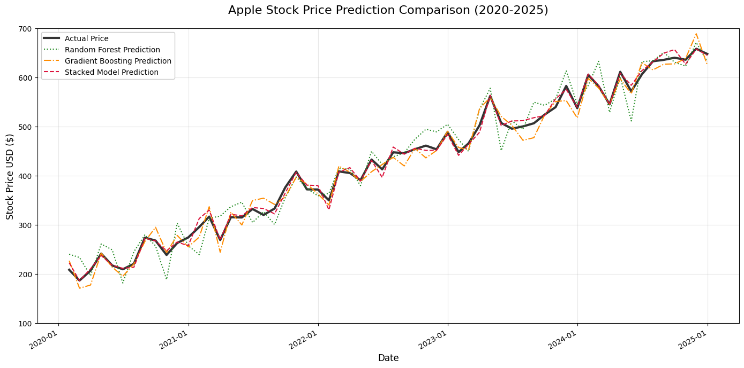
Results

Slide 26
Conclusion and Future Scope
The visualizations confirmed that the stacked model closely followed the actual stock price trajectory with minimal deviation, even in turbulent phases.
Future Scope:
Hybrid Modeling with Deep Learning: Future improvements can involve integrating the traditional machine learning methods with advanced deep learning models such as LSTM and GRU.
Real-time Model Deployment: For practical use, deploying the model in real-time is essential. This could involve developing a web application or API-based architecture using tools like Flask, enabling users to input live data and receive predictions instantly.
Backtesting and Live Trading Simulation: Future work could also include rigorous back testing frameworks to evaluate the model’s effectiveness over historical periods and simulate its impact in a live trading environment.

Slide 27
THANK YOU

